Slide 1
Making this resource work for you
Prior to teaching this lesson, please refer to the ‘Unit Overview and Planning Document’.
Further guidance on planning Science Mastery lessons can be found in the detailed planning guidance document.
Refer to the ‘notes’ section on each slide for useful information, including suggested expositions, pedagogical content knowledge, suggested questions, answers and more. Consider using presenter mode so you can see this guidance throughout the lesson.
The introduction slides can be adapted to suit your teaching style and the needs of your class.
Before the lesson, adapt the fix-it slide to address any misconceptions identified in the previous lesson’s exit ticket.
Choose from the suggested activities to suit your class. The intention is not that you complete all of these, but that you select those which ones are most appropriate for your students. It may be appropriate to further adapt activities for your students.
These lessons are designed to occupy approximately 1 hour. To adapt for a shorter or longer lesson duration we advise you to adapt the activity section accordingly.
Please consider using the final slide to send feedback about this lesson or examples of PowerPoints that you have adapted to our design team. Your feedback is used to improve Science Mastery for all of our teachers and students. We appreciate all suggestions and comments.
Thank you for reading!
The Science Mastery Team

Slide 2
How Humans Affect Biodiversity
Answer the following questions:
State the definition of biodiversity.
State the definition of an ecosystem.
Why is high biodiversity important for an ecosystem?
State the type of sampling that would be used to estimate the total population of dandelions in a field.
Explain why it is important to take repeat measurements.
The variety of different species in an ecosystem
The interaction of a community of organisms with the non-living parts of their habitat
Each species is not dependent on just one other species
Random sampling
To ensure that data is accurate.
Notes:
Purpose: to assess learning at the beginning of the new unit and interleave key prior knowledge from B1.3.
Foundation question: Describe what a quadrat is used for.
Answer: A piece of equipment used to count the number of organisms/individuals in a specific area.
Stretch question: Describe the different types of pollution.
Answer: air pollution (caused by gases such as carbon dioxide and sulfur dioxide), land pollution (from landfill sites), water pollution (from sewage and eutrophication), noise pollution, visual pollution

Slide 3
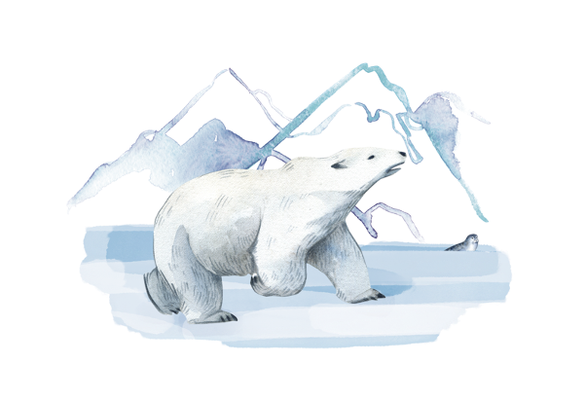
B3.2.3
11/02/2025
How Humans Affect Biodiversity
B3.2.1 Prior Knowledge Review
B3.2.2 Biodiversity
B3.2.3 How Humans Affect Biodiversity
B3.2.4 How Humans can Preserve Biodiversity
B3.2.5 The Effect of Pollution on Biodiversity
B3.2.6 Global Warming
B3.2.7 Taking It Further: Pyramids of Biomass
B3.2.8 Taking It Further: Farming and Biotechnology
B3.2.9 Taking It Further: Food Security
Notes:
Big Idea: Organisms are Interdependent
Pupils have previously (B1.3) learnt about food webs and interdependence in ecosystems, in this unit so far the have learnt about biodiversity and how It can be measured. In this lesson pupils will learn about some of the actions humans take that can reduce biodiversity such as deforestation and peat bog destruction.
Suggested Hook:
We have learnt about biodiversity and what it means, but what happens if humans intervene with the natural environment? Is biodiversity even important for humans? Do you think it matters if the biodiversity in an area changes because of human interference?

Slide 4

Following this lesson, students will be able to:
State that the growth of the human population has increased demand for resources
Describe the harmful effects that humans are having on biodiversity
Explain why scientific data can sometimes be uncertain or incomplete
Key Words:
biodiversity
population
deforestation
resources
Notes:
Can be edited depending on class need.

Slide 5
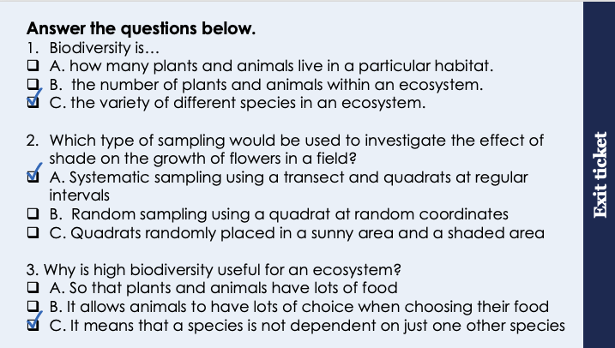
This is the fix-it portion of the lesson
The fix-it is an opportunity to respond to gaps in knowledge, especially those identified by the previous lesson’s exit ticket.
The teacher should customise this slide as needed, to facilitate
reteach, explanation, demonstration or modelling of ideas and concepts that students have not yet grasped or have misunderstood.
practise answering specific questions or of key skills.
redrafting or improving previous work.
Notes:
Purpose: to spend time on any gaps identified in previous learning from exit ticket feedback.
Fix it guidance from previous exit ticket:
Q1. Answer: C
If students answer A or B, they need to practice the definition of biodiversity. To fix it it may be useful to highlight that biodiversity is not necessarily the number of individual organisms within a species but rather the variety of different species. It may also be useful to remind pupils of the effects on a food web if a species becomes endangered/extinct.
Q2. Answer: A
If students answer B or C, they have misunderstood sampling techniques. To fix it you could go through the logic of why systematic sampling has to be used to look for the effect of a factor – if random sampling was used for this it may end up having a large number of samples within one area (e.g. a shaded area) and a small number of samples in another (e.g. a sunny area), which would skew results. Pupils may find it useful to be given a list of scenarios to determine the correct method of sampling to use.
Q3. Answer: C
If students answer A or C, they have not appreciated that organisms rely on each other for reasons other than food. To fix it you might give examples of where organisms rely on each other for a habitat (eg birds and trees) and what the impacts would be if the habitat was removed. For example in a forest with only one type of tree if that species was struck by a disease all trees would be affected so birds would have nowhere to nest. But I a forest with multiple species of tree birds would be less affected as there are other types of tree that may not be affected by the disease.

Slide 6
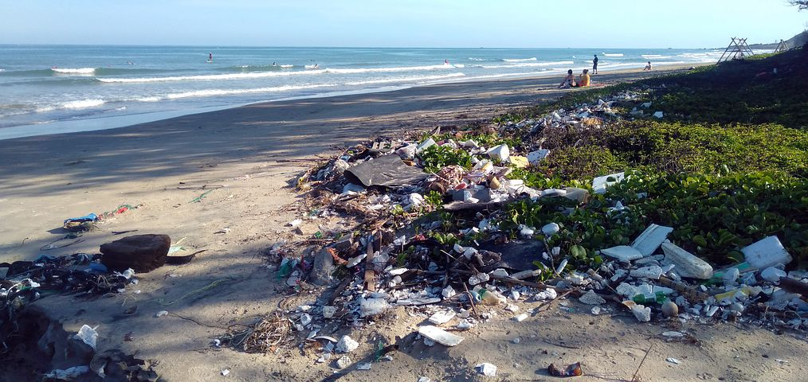
Human Effects on Biodiversity
Global population has increased from 1 billion in 1800 to 7.9 billion in 2020
Huge growth of the human population means more resources are used and more waste is produced
Many human activities are reducing biodiversity on Earth
For future food sources and human survival, action must be taken now to maintain biodiversity
Notes:
Purpose: introducing new knowledge
Exposition Type: Explanation
Suggested Script:
It may be useful to introduce a small example of this using numbers of pupils in a school – if the number of pupils in school was to double, the school would need twice as many resources, twice as many teachers (e.g. resources) and would produce double the amount of waster (e.g. litter in the playground and sewage). Imagine this happening all over the world and it suddenly becomes quite overwhelming! (Population growth is a really engaging link with geography – e.g. one child policy in China.)
Human survival depends on biodiversity to maintain a variety of food sources – decreasing biodiversity would have a huge knock on effect on food webs and decrease the number of food sources – a useful example to use is the potato famine in Ireland, where diets where predominantly based around potatoes and the famine (a fungus that destroyed up to 75% of potato crops) completely depleted the resources, resulting in the starvation of millions (population was reduced by around 20%). Other examples are a number of African communities that are completely reliant on maize, which can be devastated by droughts.
Additional information:
This is a really engaging topic for pupils and is really good to centre a debate around – UN Paris climate agreement aims to keep global temperature increase below 2 degrees using 20/20/20 (20% reduction in carbon emissions, 20% increase in renewable energy market share and 20% increase in energy efficiency). USA pulled out of the Paris Agreement in 2020 so it is very interesting to discuss the implications and ethics that this involves:
USA is one of the most populous countries and produces a large proportion of the emissions – what is the effect of this on other countries and overall emissions?
Why should one country not have to follow the same standards as others?
Is it fair to ask developing countries to contribute equally to renewable energy schemes?
More economically developed countries have already added significantly more to emissions over the past two centuries, is it fair to ask less economically developed countries not to do the same?
Image from pixabay

Slide 7
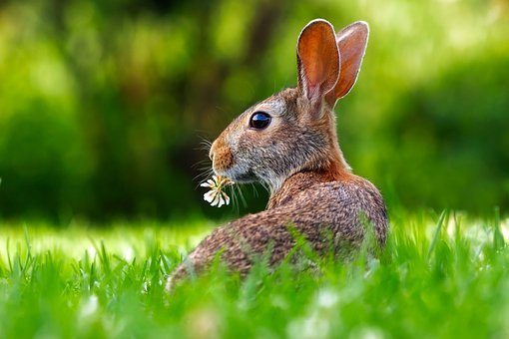
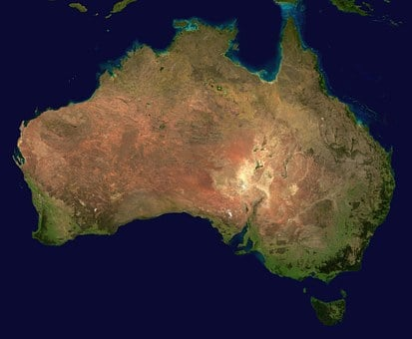
Human Effects on Biodiversity
Introducing non-indigenous species can reduce biodiversity if the species out-competes or kills indigenous species
This could mean the non-indigenous species:
Is a predator to indigenous species
Outcompetes indigenous species for food
Destroys the habitats of indigenous species
Notes:
Purpose: introducing new knowledge
Exposition Type: Explanation
Suggested Script:
An example of a non-indigenous species, which means that that species is not naturally found in that particular habitat, that destroyed a huge area of habitats in Australia was the introduction of European rabbits. In 1859 European rabbits were introduced into the Australian wild by settlers so they could hunt them. It is thought that only 13 rabbits were introduced, in only 50 years, the invasive (non indigenous) rabbits had spread across the entire country. What effect do you think the rabbits has on the indigenous plants and animals? They would have eaten many of the crops, reducing food for humans and eaten many of the plants, reducing food for the indigenous herbivores. They also negatively affected agriculture and plants by overgrazing. This led to habitats of other species being destroyed and subsequently reduced biodiversity. Rabbits are very adaptive and only need soil for burrowing and grass for grazing meaning they can live well in many habitats. They reproduce very rapidly at a young age and can produce up to 20 kittens (baby rabbits) in a year. As rabbits were non-indigenous they have no natural predators in Australia and therefore took over very easily. It is now illegal to own a pet rabbit in the state of Queensland, Eastern Australia!
https://www.nationalgeographic.org/article/how-european-rabbits-took-over-australia/
Images from pixabay

Slide 8
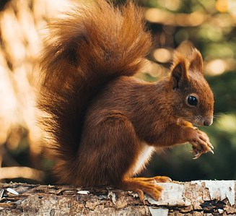
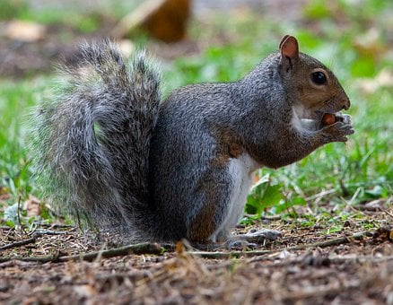
Squirrels in the UK
The red squirrel is indigenous to the UK, the grey squirrel was introduced in the 1800s from America. Now the grey squirrel is dominant across the UK.
Grey squirrels can carry a disease that is fatal to red squirrels but does not affect grey squirrels.
Grey squirrels are more confident and aggressive
Grey squirrels eat acorns when they are still green, whereas red squirrels wait for them to ripen
Why do you think the introduction of the grey squirrel caused a reduction in biodiversity?
Notes:
Suggested script:
If an ecologist claimed that the number of red squirrels had halved from 1945 to 1980, what other data would be need to support this scientific claim? Data of total squirrel numbers in 1945 and 1980.
Expected answers:
The grey squirrel is bigger in mass and longer tail, so can outcompete the red squirrel for food and space (the grey squirrels do not attack or kill the red squirrels directly)
The grey squirrel is a carrier for squirrelpox yet the red squirrel is victim to the disease can be passed to the red squirrels easily - this kills red squirrels not grey squirrels
Grey squirrels are more confident and aggressive so can find a mate more easily or fight for food
Grey squirrels eat the acorns before the red squirrels, reducing the food source for red squirrels
https://squirrelaccord.uk/squirrels/distribution/
You may want to talk through what this is showing over time because this is a lot of data to process. Perhaps cover up each map and introduce them one by one, explaining what year each one represents, which would reduce the cognitive load on students.
Suggested guidance:
Talk tasks can be used in a variety of ways to suit the particular needs of the students you are teaching. Through exchanging views with others, students develop their understanding of the science beyond what could be achieved individually.
Science classrooms that successfully integrate talk have the following features:
Science talk is a regular feature of lessons and is woven into classroom activities.
Students are paired or grouped strategically by the teacher to ensure productive interaction. This might take into consideration the students’ proficiency of the English language, how encouraging they might be to peers and their attainment in the topic. It’s a good idea to consider these pairings in the class seating plan.
Students are encouraged and supported to talk, but are not forced to talk.
The teacher should take on the role of a facilitator, engaging with conversations where necessary and encouraging or steering the conversation where needed.
Students are encouraged to use the language they have to express their ideas (e.g., everyday language, imperfect English, native language), but also to incorporate science specific terminology where this is more accurate or has been taught.
6. Scientifically inaccurate ideas are not dismissed by the partner or teacher; open discussion and further investigation are relied on to help students construct ideas that support them to progress in their scientific understanding.
7. Guidelines for behaviour during talk tasks are explicit and frequently reviewed. Rules for students might be:
Listen carefully to your partner
Take turns talking.
Speak one at a time, without interrupting.
Politely agree or disagree and explain why.
Politely point out if your partner has used a scientific word incorrectly, if they have explained the science incorrectly, or if there is a more accurate way to describe something.
If confused, ask questions.
Stay focused on the discussion topic.
Respond to one another.
Images from pixabay

Slide 9
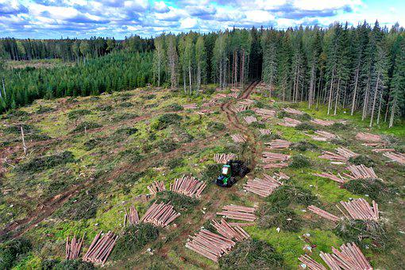
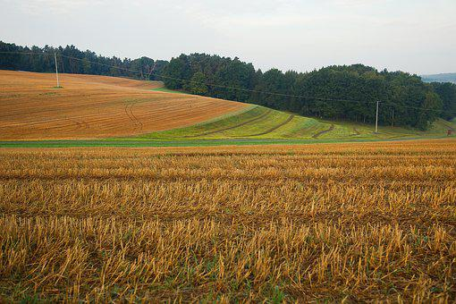
Human Effects on Biodiversity
Humans reduce the amount of land available through:
building
quarrying
farming
waste disposal
deforestation
Deforestation is used for cattle farming, rice farming and for growing crops used as biofuel
Notes:
Purpose: introducing new knowledge
Exposition Type: Explanation
Suggested Script:
The amount of land available has decreased, reducing plant and animal habitats. Humans use land for a number of reasons:
building can refer to any type from buildings for industries to homes and schools.
Quarrying is the removal of rocks, sand, gravel or other minerals from the ground often to use them for the production of construction materials.
Farms are present across the world and can be used for growing crops, rearing animals or both.
Waste disposal centres mainly refers to landfill sites. Largest landfill site in the world is Puente Hills in California – it is 150m high and 2.8 square km. (It may be useful to discuss the advantages and disadvantages of waste disposal methods – landfill destroys habitats but burning waste creates a huge amount of carbon emissions.
What is deforestation? Deforestation is when forests are cleared to make space for farming: for animals such as cattle, for crops such as rice and for crops used in biofuel. Deforestation is happening in tropical rainforests like in the Amazon in South America.
Deforestation has a massive impact on the amount of carbon dioxide in the atmosphere: As trees usually take in carbon dioxide, deforestation reduces the rate at which carbon dioxide is removed from the atmosphere. As well as this, burning the trees from deforestation releases carbon dioxide via combustion, adding to atmospheric CO₂ levels. After deforestation has happened, dead vegetation in the area decomposes- the decomposers (microorganisms) responsible for this also release CO₂ when they respire- further increasing the amount of CO₂ released.
All of these processes involve humans interfering with natural land and therefore changing (usually destroying) habitats. This lead to reduced biodiversity in the areas affected.
Images from pixabay

Slide 10
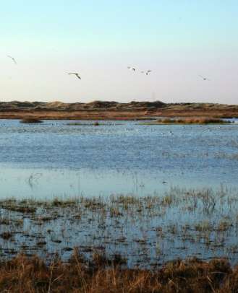
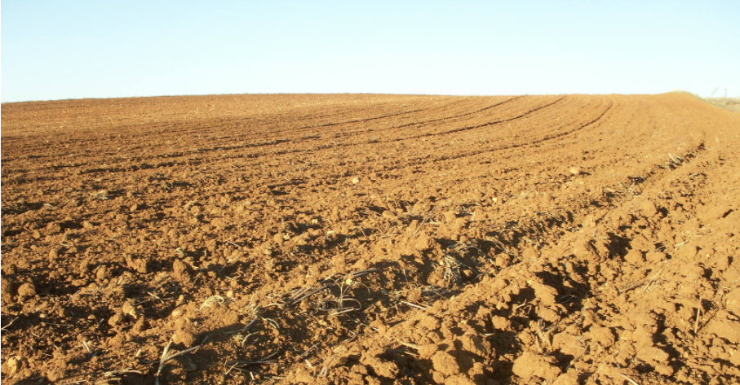
Human Effects on Biodiversity
Peat is formed when dead plant material cannot decay because of acidic and anaerobic conditions.
Peat bogs are being destroyed to provide garden and farming compost
Decaying or burning peat releases carbon dioxide into the atmosphere
A peat bog
Farmland with compost
Notes:
Purpose: introducing new knowledge
Exposition Type: Explanation
Suggested Script:
Peat is formed in waterlogged conditions which prevents plants and mosses, decaying when they die because of the lack of oxygen and the acidic conditions. Instead, they build up very slowly to form peat. This started to form 10,000 years ago and sometimes the peat can be more than 10 metres deep.
Peat bogs are an important habitat for a huge variety of plants, animals and microorganisms which can survive in the acidic conditions – humans need peat for making compost, which is needed for gardening and farming (to help increase food production). How do you think digging up the peat bogs affects biodiversity there? Causes a decrease in biodiversity because the habitat of many organisms is being destroyed. Peat can also be dried and then burnt as a fuel. As it takes thousands of years to form, the destruction of peat bogs is happening much faster than they can be regenerated.
Peat stores a lot of carbon (as it comes from organic plant material), so when it is burnt or is decaying, it releases carbon dioxide into the atmosphere. Increasing the levels of carbon dioxide in the atmosphere is not a good thing. Elevated atmospheric CO₂ levels contributes to global warming (which we will look at in more detail later in the unit).
Images:
https://www.freeimages.com/photo/farm-1192062
https://www.freeimages.com/photo/moor-1-1404375

Slide 11
Quick Quiz
Answer the following questions:
What are the effects of the human population increasing?
What is the disadvantage of using peat bogs for compost?
Why is it important for humans that biodiversity is maintained?
Name three ways that humans are destroying animal habitats.
More resources used, more waste produced
Habitats are being destroyed, decreasing biodiversity
So that humans are not dependent on one food source alone
Waste disposal, pollution, farming, deforestation, destroying peat bogs
Notes:
Purpose: review of new information.
These questions can be edited depending on the information you would like pupils to focus on. One of the biggest pupil misconceptions is not understanding that humans will be directly impacted by decreasing biodiversity – it is not just a case of maintaining plant and animal populations because ‘it is the right thing to do’, humans actually need biodiversity to survive.

Slide 12
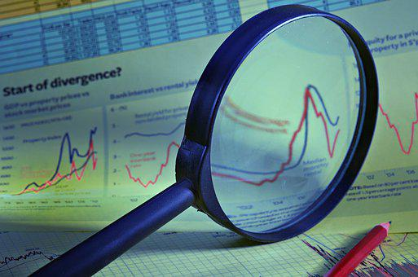
Scientific data can sometimes be uncertain or incomplete
Ecologists measure things in ecosystems to assess what is happening
Environmental data can often be uncertain or incomplete.
Scientists can decrease the uncertainty in their data by taking many readings and repeating their experiments to make their data more accurate.
Notes:
Purpose: introducing new knowledge
Exposition Type: Explanation
Suggested Script:
Ecologists, who are scientists that study ecosystems, measure things in the environment to help them make informed, sensible judgements about what is currently happening in an ecosystem and what should be done in the future. However, often data collected from the environment can contain uncertainty or be incomplete. This could be for a number of reasons:
Instruments/equipment used are not perfectly accurate
Often sampling is used to make estimates for a large area- this is an estimate and therefore not accurate
It is difficult to identify individual variables having an affect on an ecosystem
It is important that as scientists we can identify uncertainty in data or recognise that data is incomplete when interpreting it.
In order to minimise uncertainty when completing experiments or fieldwork scientists should take many readings and repeat their work multiple times to make their data as accurate as they can. Scientists also look at other scientists’ experiments to check that their findings are reproducible, which increases our certainty that the findings are accurate.
AQA definition:
Accurate - A measurement result is considered accurate if it is judged to be close to the true value.
Uncertainty - The interval within which the true value can be expected to lie. Whenever a measurement is made, there will always be some uncertainty or doubt about the result obtained. Uncertainty can be expressed in terms of spread of values obtained. For example, a length of 56 cm ±2 cm would mean the true value could be anywhere between 54 cm and 58 cm.
https://filestore.aqa.org.uk/resources/science/AQA-SCIENCE-GCSE-SUBJECT-VOCAB.PDF
Image from pixabay

Slide 13
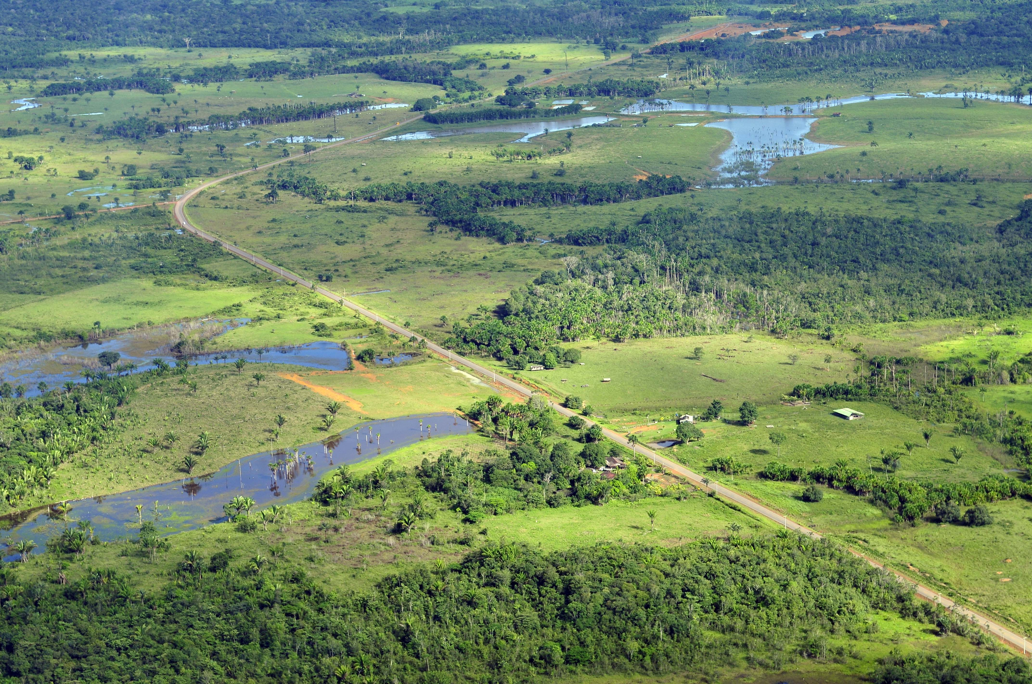
Example: images from the Brazilian Rainforest
Notes:
Suggested Script:
Many scientists agree that deforestation in the Amazon Rainforest is a large contributor to global warming and causes huge negative impacts on biodiversity because of the habitat loss involved.
But what information do scientists need in order to support this theory?
They need to provide evidence.
What kind of evidence may be useful?
Maps/satellite images to show how land use has changed over the past decades
This picture alone cannot tell us much about how much deforestation there has been because it does not have a comparison. We can say that this provides incomplete data.
Use the images from the NHM study to answer the questions:
https://www.nhm.ac.uk/our-science/our-work/biodiversity/human-impacts-biodiversity.html
Questions based on NHM pictures:
What can these images tell us?
Deforestation has increased between 1990 and 2000- you can see this from the pictures and the amount of green representing has decreased by 2000 and the amount of clear space has increased.
How could we use this information to work out what has happened to biodiversity in this area of the rainforest? Deforestation can decrease biodiversity because habitats are destroyed so we can assume biodiversity in this area has decreased.
In what ways is this ‘data’ incomplete? It cannot tell us- how many trees were removed (it can tell us area from satellite), what or how many species habitats were destroyed, what the land is now used for etc. The images are from 1990 and 2000, even the most recent image is more than 20 years old. Given the change that happened between 1990 and 2000 there could be massive changes that have happened since 2000 therefore the data is not up to date and therefore unreliable. It could be good to suggest that more recent images would be similar to repeating an experiment- the more up to date images we have the more accurate the conclusions would be. However, even with more images the data would still not be totally complete as there are points(from above) that would still not be answered.
Image source:
CC@https://commons.wikimedia.org/wiki/File:Amazon6_(5641584266).jpg

Slide 14
Drill
State one human activity that reduces biodiversity.
Define peat.
What are the conditions required for peat bogs to form?
Why are peat bogs being destroyed?
Name the greenhouse gas released when peat bogs are burned.
State how digging up peat bogs affects biodiversity.
Explain why.
Why are scientists sometimes sceptical of environmental data?
How do scientists improve the accuracy of their data?
Notes:
Purpose: This is a knowledge drill. The purpose of this is to check that the critical knowledge is secure before pupils move onto independent practice.
Suggested guidance: There are a range of ways this could be done depending on time and ability range of the class:
Mini whiteboards
As full sentences in exercise books
As short answers in exercise books
In the pupil workbook
As pair talk
As cold call

Slide 15
Drill answers
Introducing non-indigenous species, reducing the land available, digging up peat bogs, waste disposal, pollution
Peat is formed when dead plant material cannot decay because of acidic and anaerobic conditions.
Waterlogged land – lack of oxygen
To provide garden and farming compost
Carbon dioxide
Decreases biodiversity
Because the habitat of many organisms is destroyed.
Environmental data can often be uncertain or incomplete.
By taking many readings and repeating their experiments.
Notes:
Purpose: This is a knowledge drill. The purpose of this is to check that the critical knowledge is secure before pupils move onto independent practice.
Suggested guidance: There are a range of ways this could be done depending on time and ability range of the class:
Mini whiteboards
As full sentences in exercise books
As short answers in exercise books
In the pupil workbook
As pair talk
As cold call

Slide 16

I: Explain using scientific understanding to make something clear or state the reason for something happening
Example question:
To ‘explain’ your answer should:
Begin with a scientific statement.
Use ‘this means that’, ‘because’ or ‘so’ to link your statement to the question.
In the last 250 years the concentration of carbon dioxide in the Earth’s atmosphere has risen.
Explain how an increase in carbon dioxide concentration can decrease biodiversity.
Model answer:
rise in carbon dioxide causes global warming
global warming causes extreme weather patterns
such as rise in sea levels, change in rainfall, droughts
rise in sea levels means habitats will change due to flooding
increased rainfall will increase water levels
droughts can affect plant growth
changes can cause loss of or damage to habitats
which will affect animal and plant distributions
which decreases biodiversity
Notes:
This slide models the process of answering an explain question.
Firstly, students are presented with a generic explain question, along with a model answer. Students are also given some simple guidance to follow for producing their own describe answer.
The generic question and answer should be used by the teacher to remind students of
the key features of a great answer
how to structure their answer
why the model answer is a good example
Following this, students will be required to apply this process to answer their own explain question, which will appear in place of the generic questions. This explain question will be specific to the topic students are learning about in the lesson. Give students time to write their own answer to this, ensuring that they use the guidance provided. To further scaffold this task for students, it may be appropriate to:
pair students up to write an answer together
list for students the key words you would like them to include in the answer
provide a writing frame or ‘points to include’ for students
A model answer for this question will appear. Teachers should review the model answer with students by referencing the guidance in the green box. For example ‘we can see item 1 in the guidance is to begin with a scientific statement. Notice in the model answer here we have done just that’. Or ‘item 2 in the guidance here says that we should use a linking statement in the answer. Has this been achieved in the model answer? Where can we see this?’.

Slide 17
We: Explain using scientific understanding to make something clear or state the reason for something happening
Example question:
To ‘explain’ your answer should:
Begin with a scientific statement.
Use ‘this means that’, ‘because’ or ‘so’ to link your statement to the question.
Explain how deforestation can decrease biodiversity.
Model answer:
Loss of habitat for animals
Less trees to absorb carbon dioxide by photosynthesis
This leads to a rise in carbon dioxide which causes global warming
Global warming causes extreme weather patterns
This causes loss of habitat
And change in weather patterns which affect plant growth
Notes:
This slide models the process of answering an explain question.
Firstly, students are presented with a generic explain question, along with a model answer. Students are also given some simple guidance to follow for producing their own describe answer.
The generic question and answer should be used by the teacher to remind students of
the key features of a great answer
how to structure their answer
why the model answer is a good example
Following this, students will be required to apply this process to answer their own explain question, which will appear in place of the generic questions. This explain question will be specific to the topic students are learning about in the lesson. Give students time to write their own answer to this, ensuring that they use the guidance provided. To further scaffold this task for students, it may be appropriate to:
pair students up to write an answer together
list for students the key words you would like them to include in the answer
provide a writing frame or ‘points to include’ for students
A model answer for this question will appear. Teachers should review the model answer with students by referencing the guidance in the green box. For example ‘we can see item 1 in the guidance is to begin with a scientific statement. Notice in the model answer here we have done just that’. Or ‘item 2 in the guidance here says that we should use a linking statement in the answer. Has this been achieved in the model answer? Where can we see this?’.

Slide 18
You: Explain using scientific understanding to make something clear or state the reason for something happening
Example question:
To ‘explain’ your answer should:
Begin with a scientific statement.
Use ‘this means that’, ‘because’ or ‘so’ to link your statement to the question.
Explain how landfill sites can decrease biodiversity.
Model answer:
Landfill sites take up space
This causes habitat loss
Landfill sites can cause water pollution in nearby rivers/lakes
This can damage habitat for aquatic life
Notes:
This slide models the process of answering an explain question.
Firstly, students are presented with a generic explain question, along with a model answer. Students are also given some simple guidance to follow for producing their own describe answer.
The generic question and answer should be used by the teacher to remind students of
the key features of a great answer
how to structure their answer
why the model answer is a good example
Following this, students will be required to apply this process to answer their own explain question, which will appear in place of the generic questions. This explain question will be specific to the topic students are learning about in the lesson. Give students time to write their own answer to this, ensuring that they use the guidance provided. To further scaffold this task for students, it may be appropriate to:
pair students up to write an answer together
list for students the key words you would like them to include in the answer
provide a writing frame or ‘points to include’ for students
A model answer for this question will appear. Teachers should review the model answer with students by referencing the guidance in the green box. For example ‘we can see item 1 in the guidance is to begin with a scientific statement. Notice in the model answer here we have done just that’. Or ‘item 2 in the guidance here says that we should use a linking statement in the answer. Has this been achieved in the model answer? Where can we see this?’.

Slide 19
Interpreting data
Year | Estimated Amazon Deforestation Rate (km^{2/}year)
2010 | 6400
2016 | 7800
2017 | 6700
Use the data from that table above to answer the following questions:
Describe the deforestation rates between 2010 and 2017.
How could this affect the biodiversity of the Brazilian rainforest?
Explain whether this data allows you to make an accurate conclusion about the change in deforestation rate.
How could the accuracy of this data be increased?
Notes:
Answers:
Between 2010 and 2016 deforestation rates increased from 6400 to 7800 km^{2/}year. Between 2016 and 2017 the rates then decreased from 7800 to 6700 km^{2/}year.
Deforestation can cause a decrease in biodiversity in the affected area due to loss of habitats.
The data does not allow you to form an accurate conclusion as there is only data present for 3 different years. This means that long term trends cannot be seen and data is missing between 2010-16. (There are also many things this data cannot tell us about deforestation as in the example on the previous slide)
Any one from:
Taking more regular measurements, e.g. every 6 months, which would increase the accuracy because there is more data from which to identify a trend
More data across a longer time span to see long-term trends in deforestation rate
Measurements could be made to 4 significant figures which could increase accuracy

Slide 20
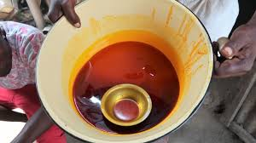
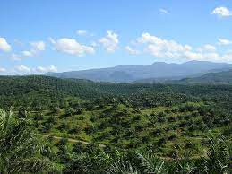
Evaluate: to make a conclusion based on evidence
There is growing pressure on national Governments to ban the use of Palm Oil in cosmetics and toiletries, as large areas of palm trees in Africa and South East Asia have been destroyed to manufacture the oil.
The palm oil industry involves thousands of jobs in different countries, but its manufacturing process often destroys the habitat of many species.
a) Evaluate the use of palm oil in the cosmetic industry, citing arguments both for and against its use.
b) Determine whose responsibility it is to reduce the use of palm oil.
To ‘evaluate’ your answer should:
Use the information supplied and our own knowledge to consider the evidence for and against a point.
We may also be required to include a justified conclusion. This may sometimes be our opinion.
Notes:
Purpose: practice application of new information
This can be used as a stretch activity. You may want to get pupils working in groups to plan and construct an answer. Alternatively you could nominate a spokesperson to speak on behalf of palm oil manufacturing companies or environmentalists.
Possible statements:
Economically important to many countries
Employs a huge number of people
Very useful in commercial products
There are sustainable methods to obtain palm oil
Loss of habitat for endangered species
Deforestation is contributing to global warming
Determine whose responsibility it is to reduce the use of palm oil.
Opinion statement – manufacturers, governments or individuals
Image source
https://commons.wikimedia.org/wiki/File:Palm_oil_in_a_bowl.jpg
https://commons.wikimedia.org/wiki/File:Oil_palm_plantation_in_Cigudeg-03.jpg

Slide 21
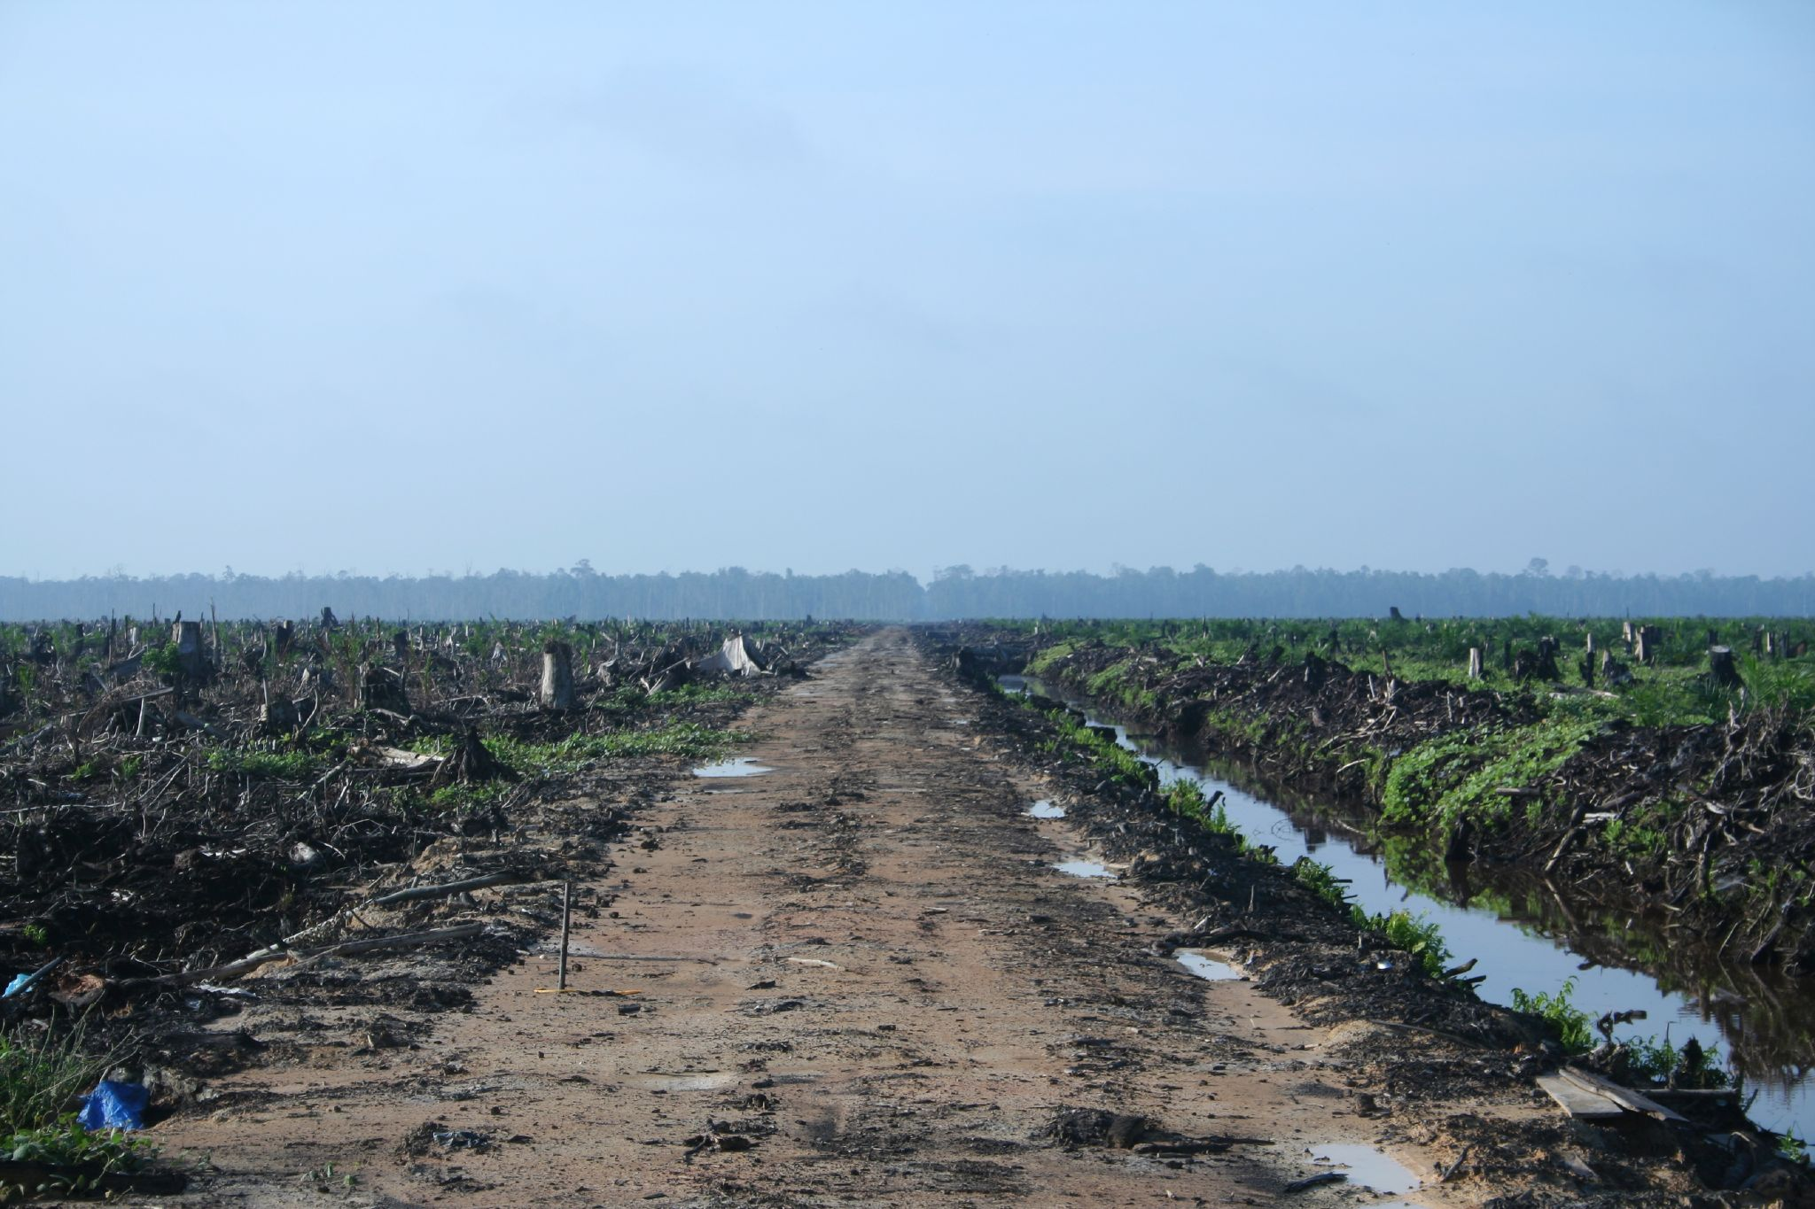
Answers
a) The production and use of palm oil can be beneficial to many people. The industry employs a large number of people and is economically important to many countries that manufacture and sell palm oil. As it can be a relatively cheap product is a useful ingredient for many commercial products.
However, deforestation is required for palm oil to be produced. This is a process that is extremely detrimental to the environment both contributing the CO2 emissions (and therefore global warming) and destroying the habitats of many species of plants and animals, some of which may be endangered.
b)I think it is the job of the …………..
I think this because ………
Notes:
Purpose: practice application of new information
Answers:
Possible statements:
Economically important to many countries
Employs a huge number of people
Very useful in commercial products
There are sustainable methods to obtain palm oil
Loss of habitat for endangered species
Deforestation is contributing to global warming
Determine whose responsibility it is to reduce the use of palm oil.
Opinion statement – manufacturers, governments or individuals

Slide 22
Answer the questions below.
Which statement is correct?
A. It is fine to destroy peat bogs as long as peat is not burnt
B. Peat bogs are a very large carbon store
C. No species can live in a peat bog as it is acidic
2. Which best explains an effect of a growing population?
A. Humans need more food than animals so more crops have to be grown
B. More humans are growing bigger so need more food
C. Humans are destroying habitats to be able to grow more crops
3. Which of these actions would not decrease biodiversity?
A. Maintaining natural land
B. Introducing a new species into an ecosystem
C. Clearing forests to grow one single crop
✓
✓
✓
Notes:
Q1. Answer: B
If students answer A or B, they do not fully appreciate what a peat bog is. To fix-it, it may be useful to show a large photo of a peat bog to show the organisms that can live there even in the acidic conditions and therefore if the peat is destroyed habitats are also destroyed.
Q2. Answer: C
If students answer A or B, they have either overestimated the importance of humans (i.e. that we are more important than other species) or they have misunderstood the term growing population. To fix-it revise the idea that more people need more resources and produce more waste, rather than people themselves are actually growing taller.
Q3. Answer: A
If students answer B or C, they may not have linked the cause from the answer with the effect of reducing biodiversity. To fix-it go through each example and get pupils to state if it would benefit or potentially harm the organisms already living there. For example B ask them to identify the reasons a new species could harm other organisms living there (from slide 7). An example of an invasive plant species such as Japanese Knotweed could also be introduced.

Slide 23
Lesson B3.2.3
What was good about this lesson? | What can we do to improve this lesson?
Send us your feedback by clicking this link
or by emailing sciencemastery@arkonline.org
Thank you!

